Slide 1
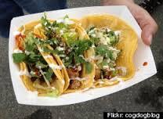
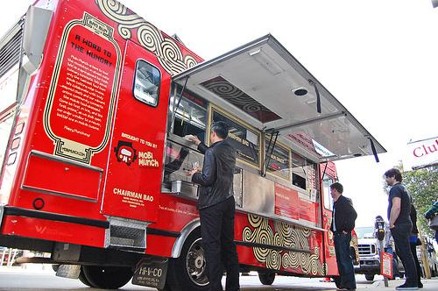
Food Truck Proposal
Paul H. Nicky J. Mike W. Emile D.

Slide 2
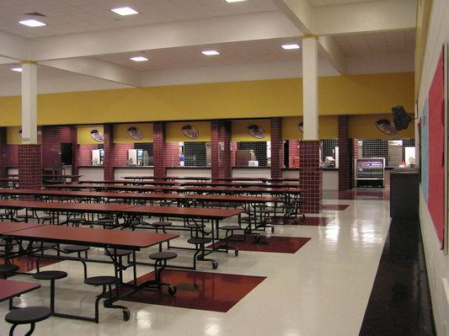
The Situation
Students aren’t compelled to eat on campus
There is little variety on campus for students to choose from
Students desire delicious food options

Slide 3
Consequences
Students are tardy to class
Students must go off campus to get good food
Car accidents because of students leaving campus
Loss of profit to current food trucks near campus

Slide 4
Food Truck Advantages
Reduction of student tardiness
Better food quality
Greater food variety
Satisfied students: increase in classroom performance

Slide 5
Misconceptions
We are NOT intending to isolate the cafeteria
we are attempting to assist in the process of renovating the food at the cafeteria

Slide 6
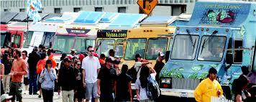
Potential Vendors
Rocko’s Chocolate Tacos
Firetrail Pizza
Wings Wings
Sugarfoot Grits

Slide 7
Objectives
To get multiple food trucks on campus at Terra Linda
To provide better food options at Terra Linda and make for a happier healthier environment

Slide 8
Proposal
To dedicate one day a week for various food trucks to come to Terra Linda

Slide 9
Next Steps
Estimate cost of permits
Contact potential food trucks
Gain approval from district

Slide 10
Thank You

