Slide 1
Child Protective Services
By Raul Jauregui, Tyra Holloway, Quadrick Reeder, Javier Padilla

Slide 2
PROBLEMS WITH CPS
Not enough case workers
People aren’t interested in becoming a CPS worker

Slide 3
What did we do?
Interviewed people who work with CPS (Child Protective Services).
Gathered information about CPS and how it functions.
Trying to spread the word about CPS not having enough workers.

Slide 4
What we asked/Who did we ask.
We talked to employees of Alameda County’s Child Protective Services Social Worker.
About how many cases are reported daily?
“That would be to say because we take so many and so many people are making reports and there are approximately 18 people taking reports so the range could be from very little to a lot.”

Slide 5
What We’ve Learned
How Dangerous Child Abuse Is.
CPS Is Low On Workers.
Every Problem Is Treated In The Same Steps.
People are not interested in this field because of the low salaries.

Slide 6
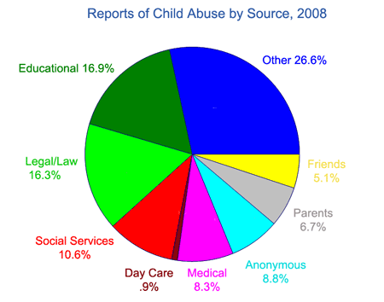
What we found/ Discovered.

Slide 7
Why can't CPS workers do their job effectively?
Not enough social workers to give every child the care they need
Not many people want to be a CPS worker
Not enough funding to higher their pay

Slide 8
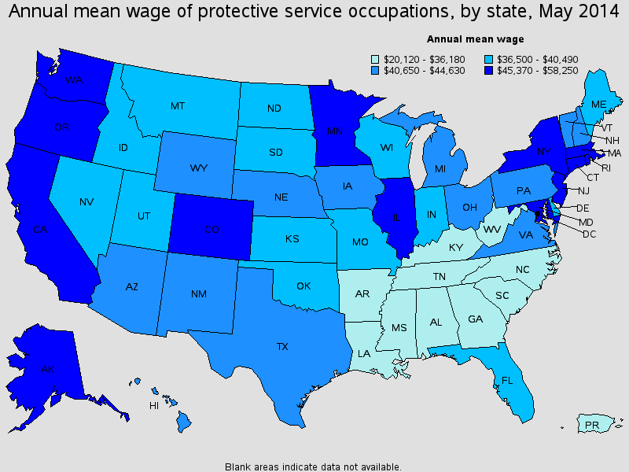
GOAL THEN
Get all cases to be treated equally
GOAL NOW
Encourage more people to become CPS workers

Slide 9
CALL TO ACTION
Become a CPS worker, HELP A CHILD!!

Slide 10
SOURCES
https://www.google.com/search?q=child+protective+services&espv=2&biw=1280&bih=923&source=lnms&tbm=isch&sa=X&ved=0ahUKEwjOzrG3xtTJAhVH8WMKHQs-C0IQ_AUICCgD&safe=active&ssui=on#imgrc=wjS7O0ZFQVp_EM%3A
https://www.google.com/search?q=child+protective+services&espv=2&biw=1280&bih=923&source=lnms&tbm=isch&sa=X&ved=0ahUKEwjOzrG3xtTJAhVH8WMKHQs-C0IQ_AUICCgD&safe=active&ssui=on#imgrc=lyaRLyHEO1QdmM%3A
https://www.google.com/search?q=child+protective+services&espv=2&biw=1280&bih=923&source=lnms&tbm=isch&sa=X&ved=0ahUKEwjOzrG3xtTJAhVH8WMKHQs-C0IQ_AUICCgD&safe=active&ssui=on#imgrc=6t2zl6P5zow1PM%3A
https://www.google.com/search?q=child+protective+services&espv=2&biw=1280&bih=923&source=lnms&tbm=isch&sa=X&ved=0ahUKEwjOzrG3xtTJAhVH8WMKHQs-C0IQ_AUICCgD&safe=active&ssui=on#imgrc=XeQGk2euBZw4RM%3A
https://www.google.com/search?q=child+protective+services&espv=2&biw=1280&bih=923&source=lnms&tbm=isch&sa=X&ved=0ahUKEwjOzrG3xtTJAhVH8WMKHQs-C0IQ_AUICCgD&safe=active&ssui=on#safe=strict&tbm=isch&q=child+protective+services+worker+jobs&imgrc=zxHe2kQLNJVgVM%3A
https://www.google.com/search?q=child+protective+services&espv=2&biw=1280&bih=923&source=lnms&tbm=isch&sa=X&ved=0ahUKEwjOzrG3xtTJAhVH8WMKHQs-C0IQ_AUICCgD&safe=active&ssui=on#safe=strict&tbm=isch&q=child+protective+services+worker+jobs&imgrc=jh_lcomcZPqHCM%3A

