Slide 1

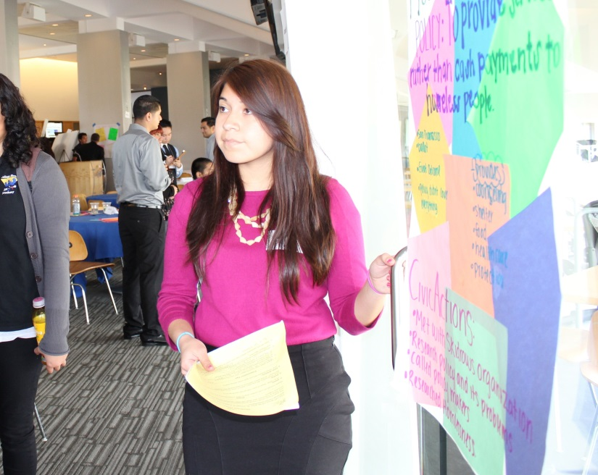
Civic Action Project
Connecting Your Government Class and the Real World
Presenters: Keith Mataya and Laura Wesley
Teachers: Michael Papritz—Kentridge High School, Mary Jo Harvey—Othello High School and Judy Smith—San Lorenzo High School
www.crfcap.org

Slide 2



Special Thanks To:
Carol Coe, from the Office of Superintendent Of Public Instruction
And
RGK Foundation

Slide 3

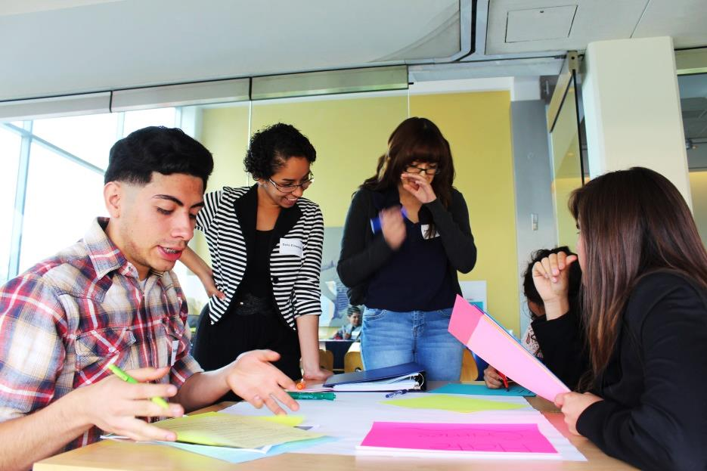
Constitutional Rights Foundation
CRF is a non-profit, non-partisan, national educational organization. For over 50 years we’ve provided programs, training, and materials supporting teachers and students in the fields of civic and law-related education.
Check us out on the web @ www.crf-usa.org

Slide 4
Objectives
Participants will...
See a Common Core-aligned PBL approach to teaching U.S. Government.
Learn how CAP meets WA new Civic Standards.
Be able to use the CAP to engage students in policy and problem solving.
See examples of student work.
Explore the CAP website resources for teachers and students
www.crfcap.org

Slide 5
Rationale for CAP
New Civics Standards - OSPI
(2)The content of the civics requirement must include, but not be limited to:
(a) Federal, state, and local government organization and procedures;
(b) Rights and responsibilities of citizens addressed in the Washington state and United States Constitutions;
(c) Current issues addressed at each level of government; and
(d) Electoral issues, including elections, ballot measures, initiatives, and referenda

Slide 6
Rationale Cont.
CCSS – Writing 12th Grade
7. Conduct short as well as more sustained research projects to answer a question (including a self- generated question) or solve a problem; narrow or broaden the inquiry when appropriate; synthesize multiple sources on the subject, demonstrating understanding of the subject under investigation.
8. Gather relevant information from multiple authoritative print and digital sources, using advanced searches effectively; assess the strengths and limitations of each source in terms of the specific task, purpose, and audience; integrate information into the text selectively to maintain the flow of ideas, avoiding plagiarism and overreliance on any one source and following a standard format for citation.

Slide 7

Civic Engagement
Skills
Knowledge
Attitudes
Change
Crfcap.org

Slide 8
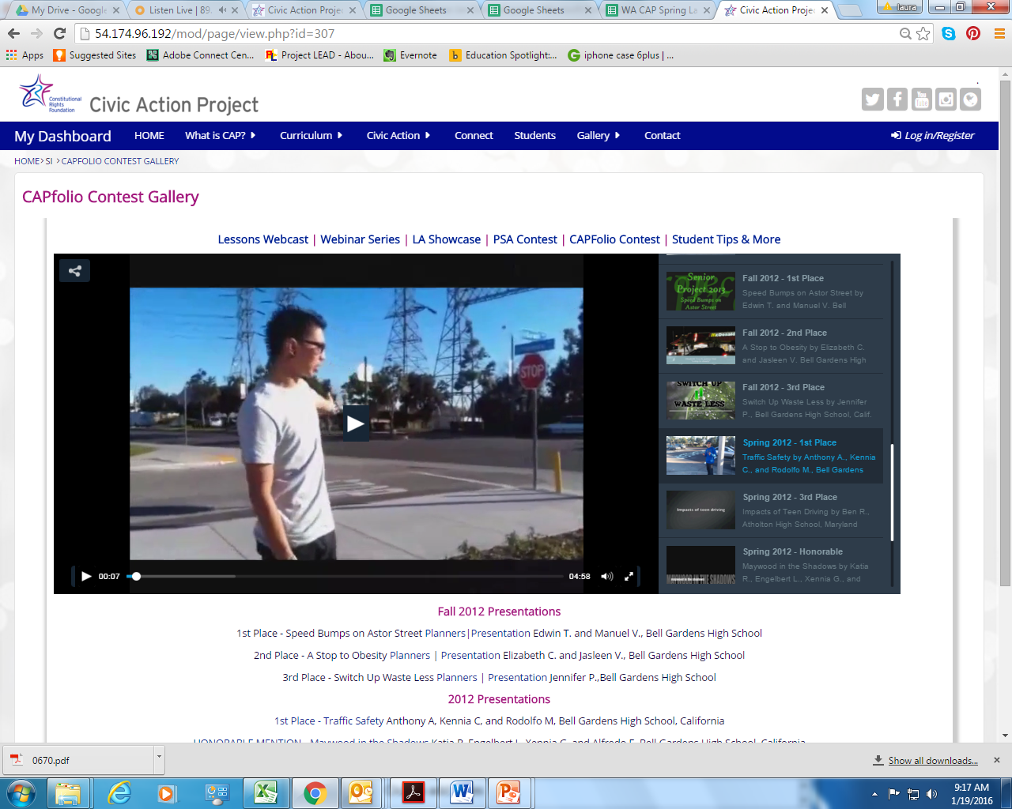
KEEP CLEAR ZONE

Slide 9
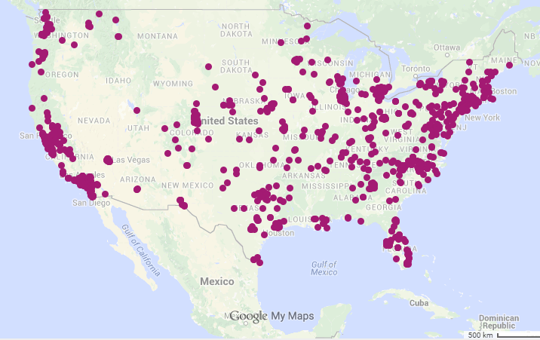
Civic Action Project
Provides students with opportunities to apply what they learn in the classroom in their community.
Introduces public policy as a tool for community problem-solving.
Opportunities for connecting with influential people in their community.
Gain practical and professional skills necessary for success after high school.
CAP NATION
Teacher
Five core lessons
Online classroom management
  Assessment Tools
Students
Planners
  Toolkit
  Discuss (Youth Board)
Public Presentation
Notes:
Lesson=Content & skills students need for CAP projects
Practicum for the U.S. Government Course.
Additional enrichment lessons
• Anticipate student needs: building constituencies, making PSAs, presentation skills
Project Based Learning
• Students select an issue/problem for teachers to approve
• Structure for students to propose and implement “civic actions” to address their issue and report on the outcomes.
• Monitoring and assessment built in.
1. Significant content
2. A Need to Know
3. A Driving Question
4. Student Voice and Choice
5. 21st Century Competencies
6. Requires In-Depth Inquiry
7. Incorporates feedback and revision
8. Results in a Publicly Presented Product

Slide 10

How to get there?

Slide 11
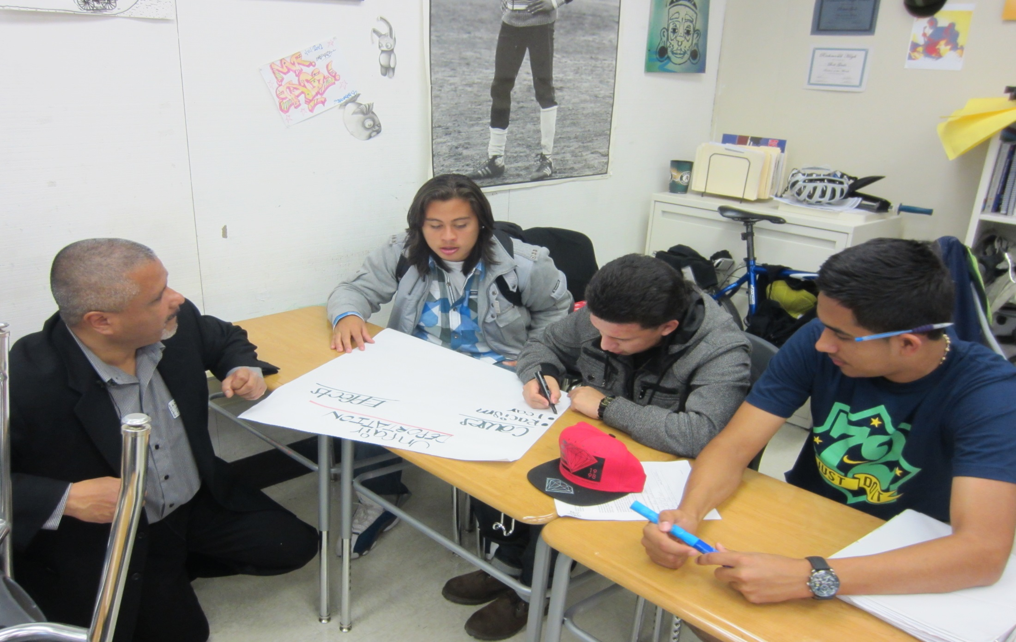
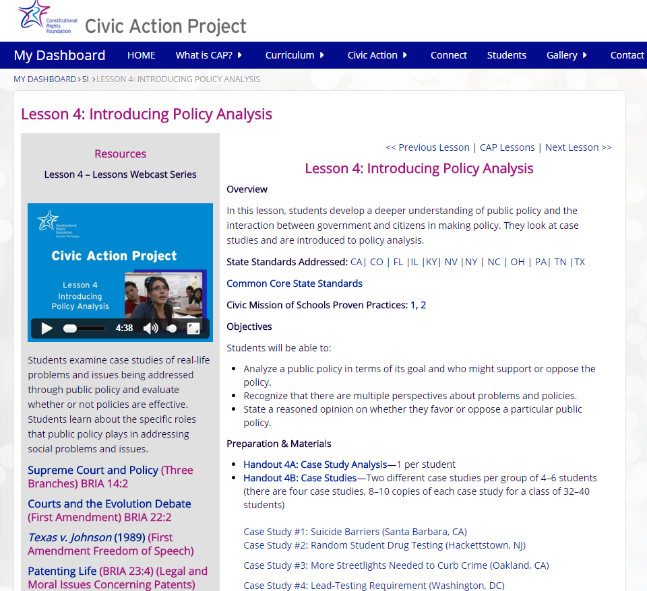
Step 1:
Teach Lessons

Slide 12
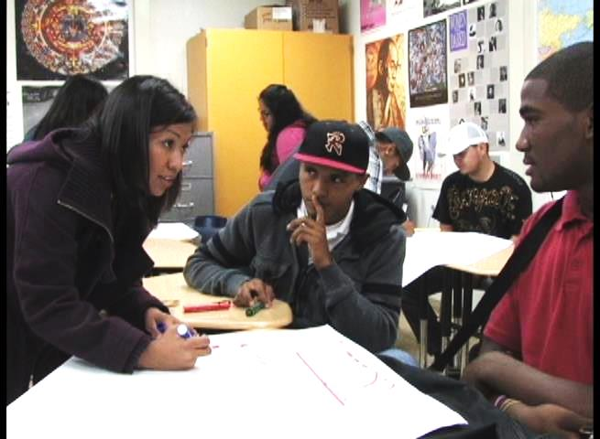
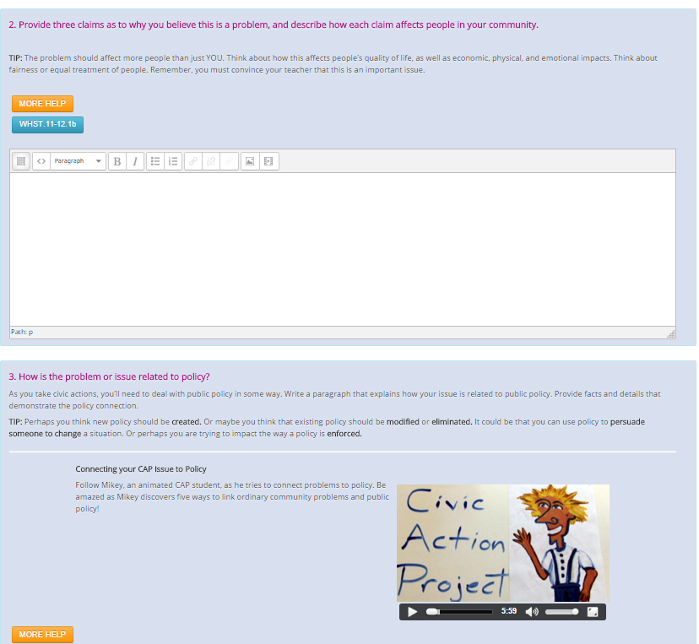
Step 2:
Students Take Action!

Slide 13
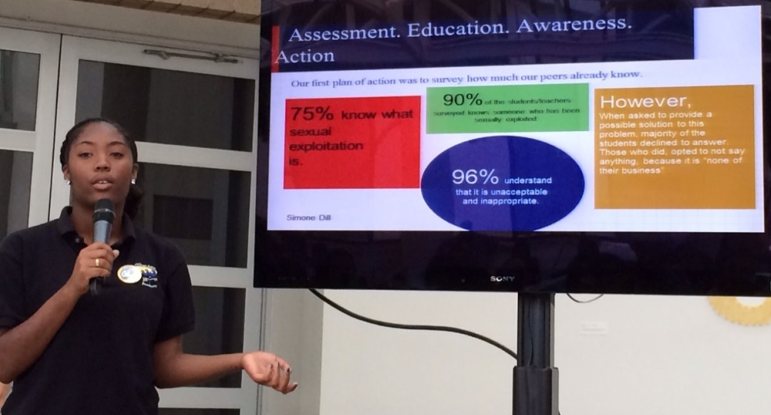
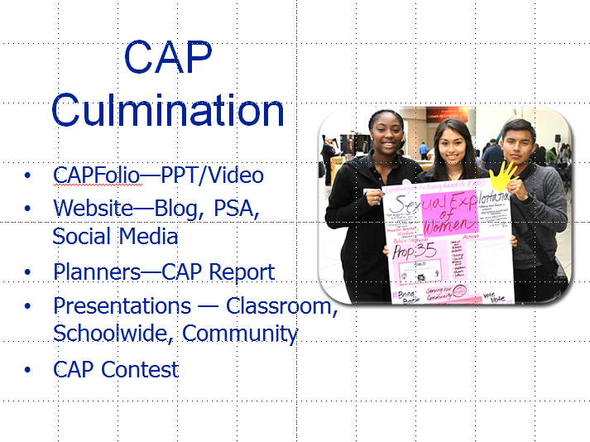
Public Presentations
Step 3:

Slide 14
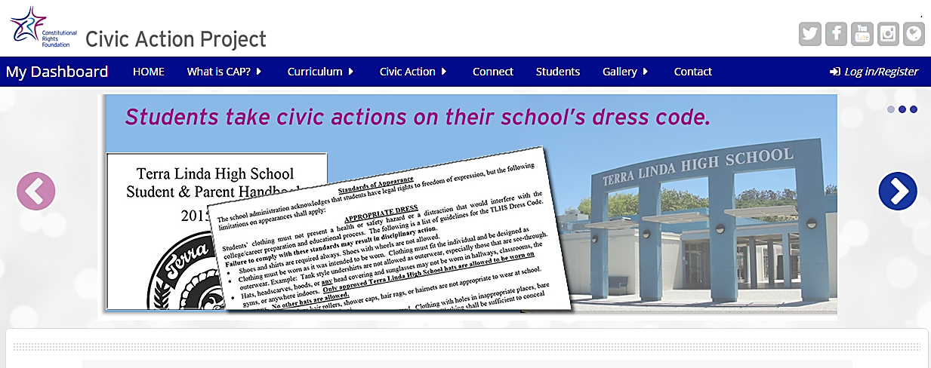
CAP Website
www.crfcap.org
Teacher Facing
Teacher Dashboard
  Lessons
  Online Classroom Management
  Teacher Created Resources
  CAP Culmination
Student Facing
Student Dashboard
  Online Planners
  Sample work & video help
  Toolkit
Discussion board
Contests
Youth Board
Notes:
CAP Planner
Mikey Video
Grading the Planner
Discussion board
Publish
Learning: Arely

Slide 15
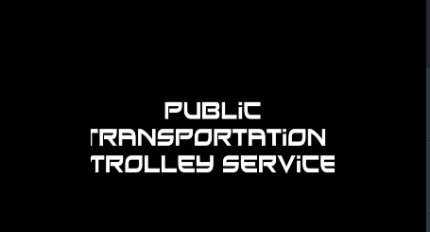
Video: The Trolley Problem
Crfcap.org
Notes:
Students will be able to:
Identify basic responsibilities and expectations of citizens.
Understand the traits of effective citizens (Knowledge, Skills, Attitudes and Actions.)
Decide on and support opinion of the most important elements of effective citizenship.

Slide 16

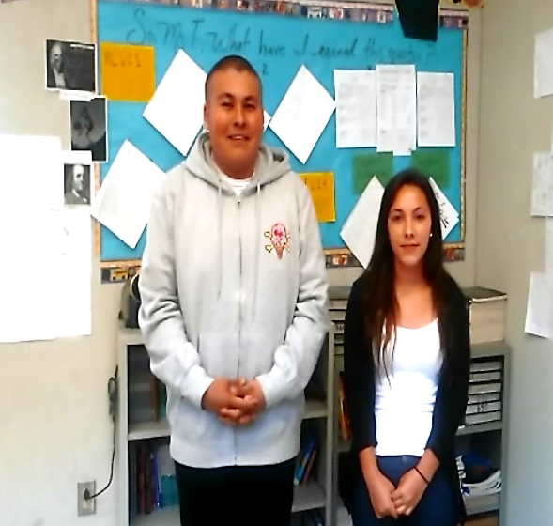

CAP
ISSUE
POLICY
ACTION
Crfcap.org

Slide 17
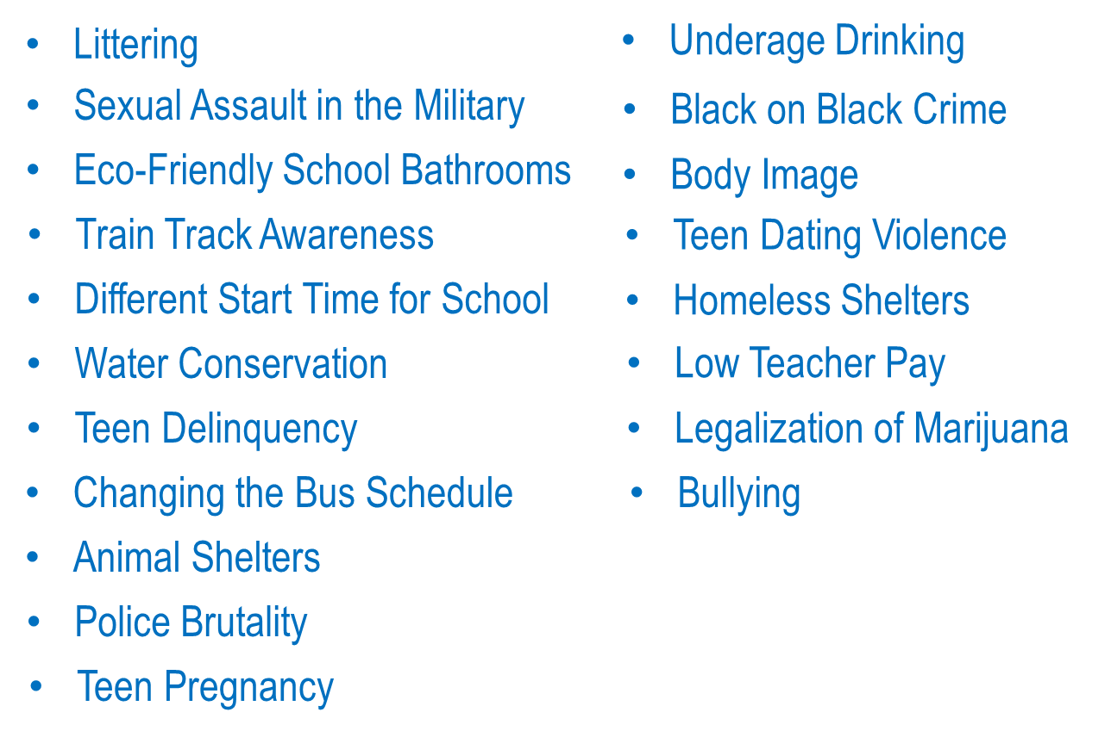
Real students. Real issues.

Slide 18
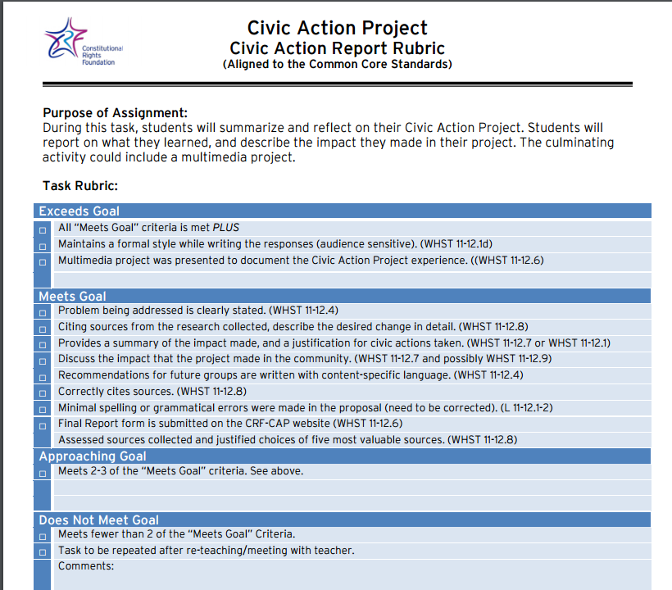
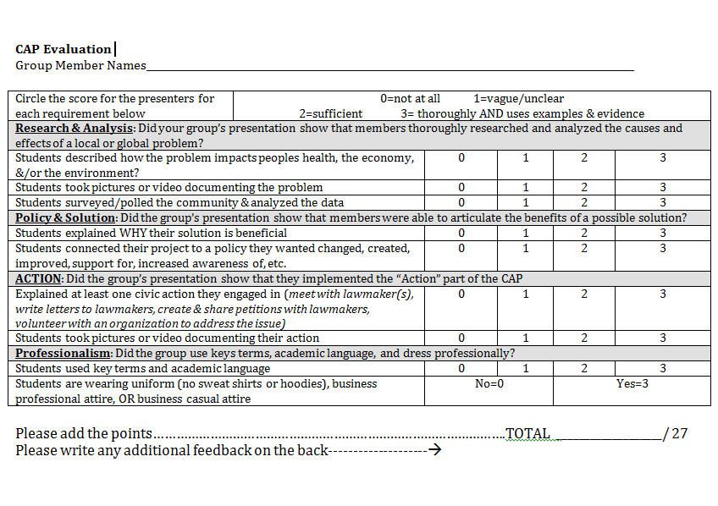
Assessment
Lessons
Planners
Presentations

Slide 19
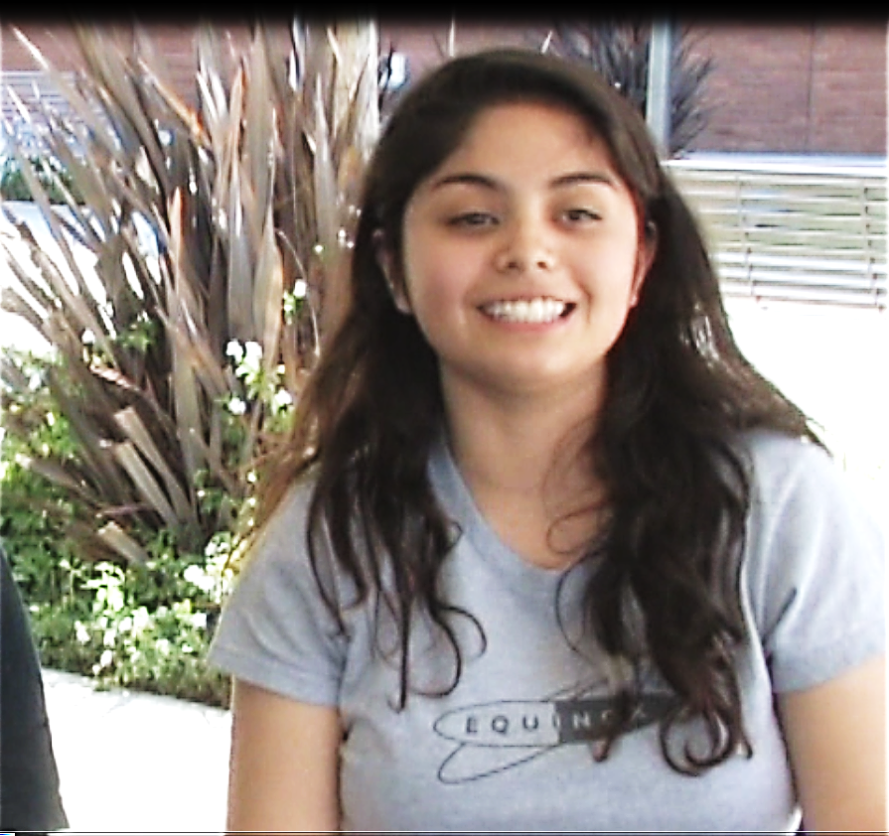
Civic Transformation
I learned that some things may not work in your favor, but if you persevere you will get results. I also improved my business letter and e-mail skills. I also learned who I can contact for assistance on certain policy matters. I learned more on how to be an active member of my community.
Arely CAP Student
Notes:
AFTER all the Lesson demos are DONE show this slide.

Slide 20
Q & A with
CAP Teachers
Michael Papritz—Social Studies Teacher and Co-Curricular Leader
Kentridge High School
Mary Jo Harvey—Modern World History & Civics
Othello High School
Judy Smith—Government and Economics
San Lorenzo High School

Slide 21
THANK YOU!
For support and information contact:
Keith@crf-usa.org
Laura@crf-usa.org
crfcap.org
crf-usa.org
www.crfcap.org

Slide 22
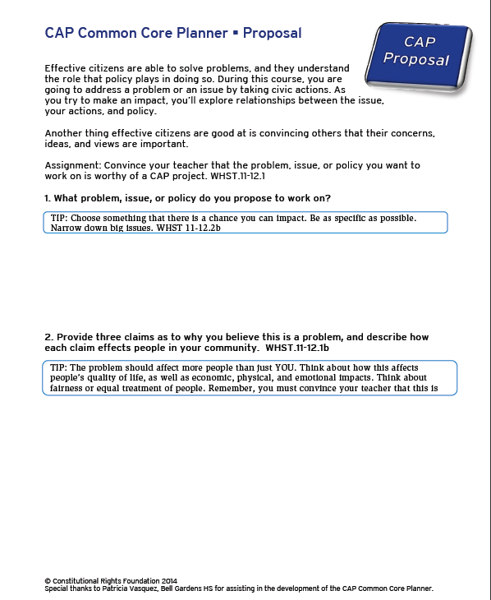
Hands-on With the Planners
Proposal
Thinking It Through
Civic Action
Report

